Slide 1
Chapter 6
Stability

Slide 2
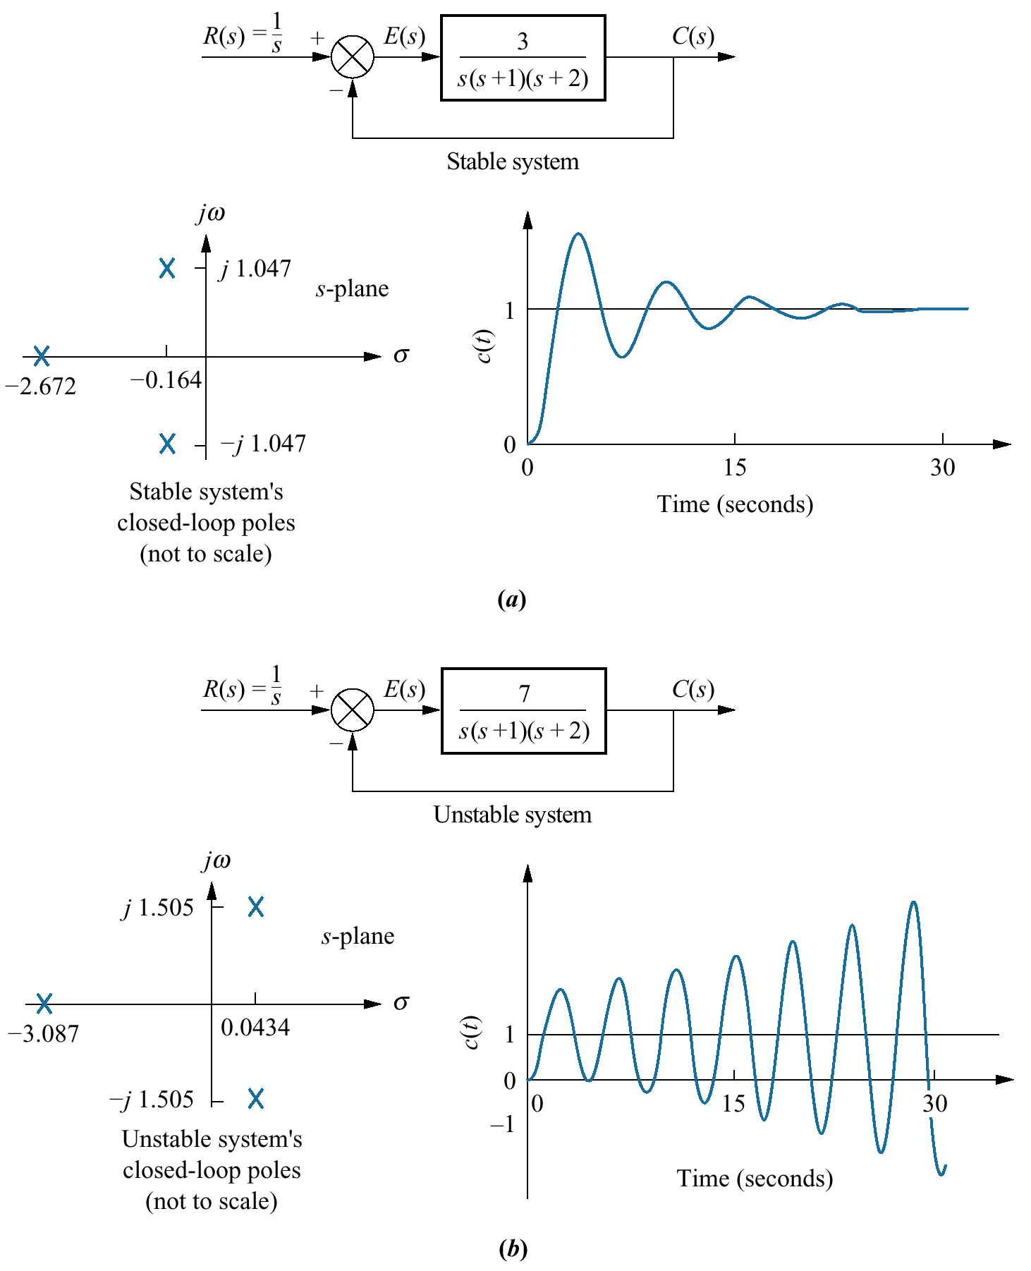
Figure 6.1
Closed-loop poles
and response:
a. stable system;
b. unstable system

Slide 3
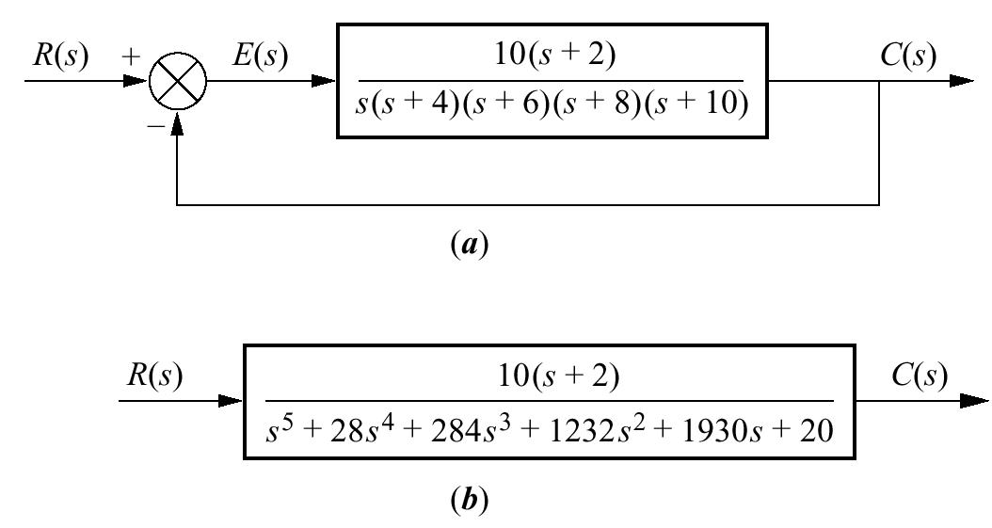
Figure 6.2
Common cause
of problems in
finding closed-loop
poles:
a. original system;
b. equivalent
system

Slide 4
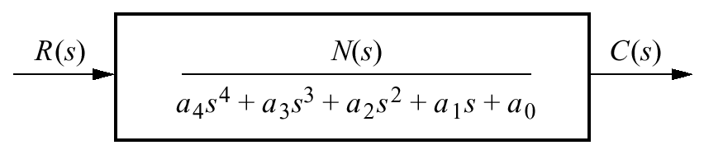
Figure 6.3
Equivalent closed-loop
transfer function

Slide 5
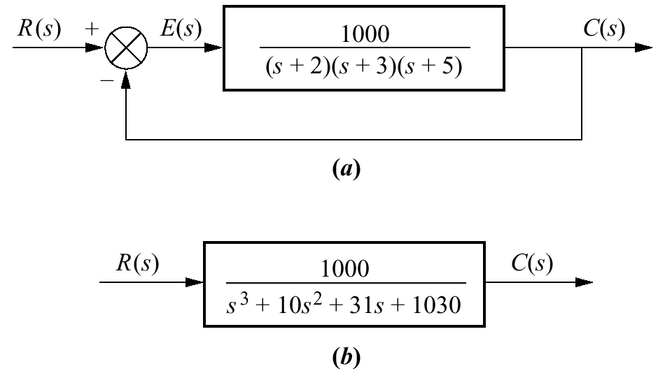
Figure 6.4
a. Feedback
system for
Example 6.1;
b. equivalent
closed-loop
system

Slide 6
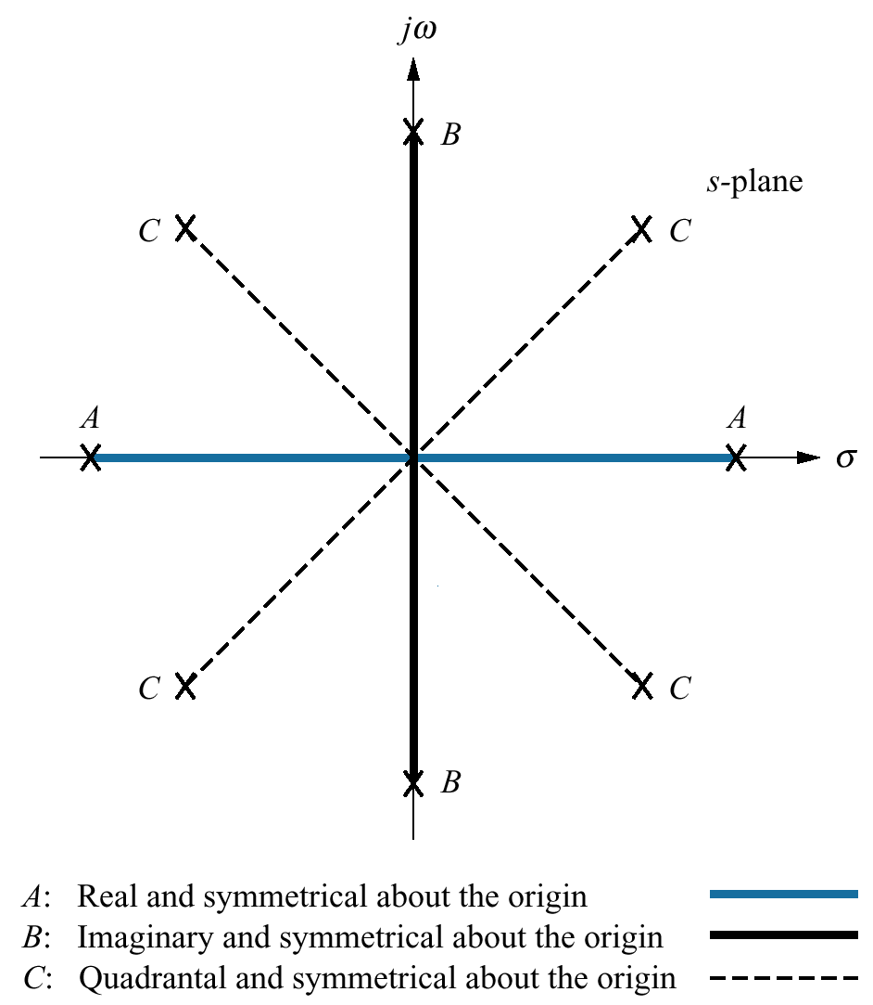
Figure 6.5
Root positions
to generate even
polynomials: A , B, C,
or any combination

Slide 7
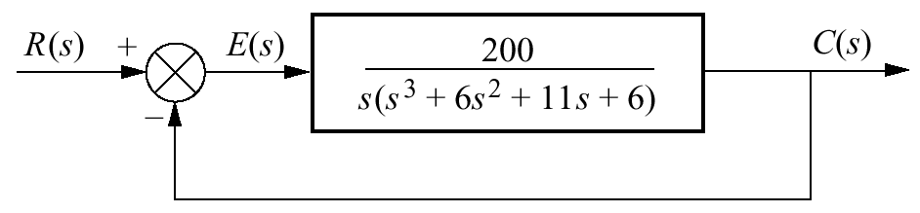
Figure 6.6
Feedback
control system
for Example 6.6

Slide 8
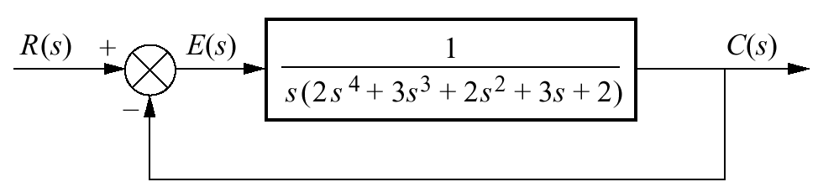
Figure 6.7
Feedback control
system for
Example 6.7

Slide 9
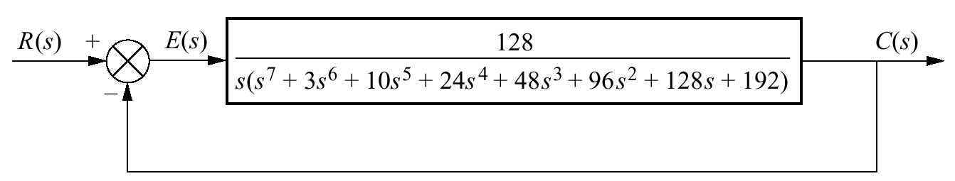
Figure 6.8
Feedback
control system
for Example 6.8

Slide 10
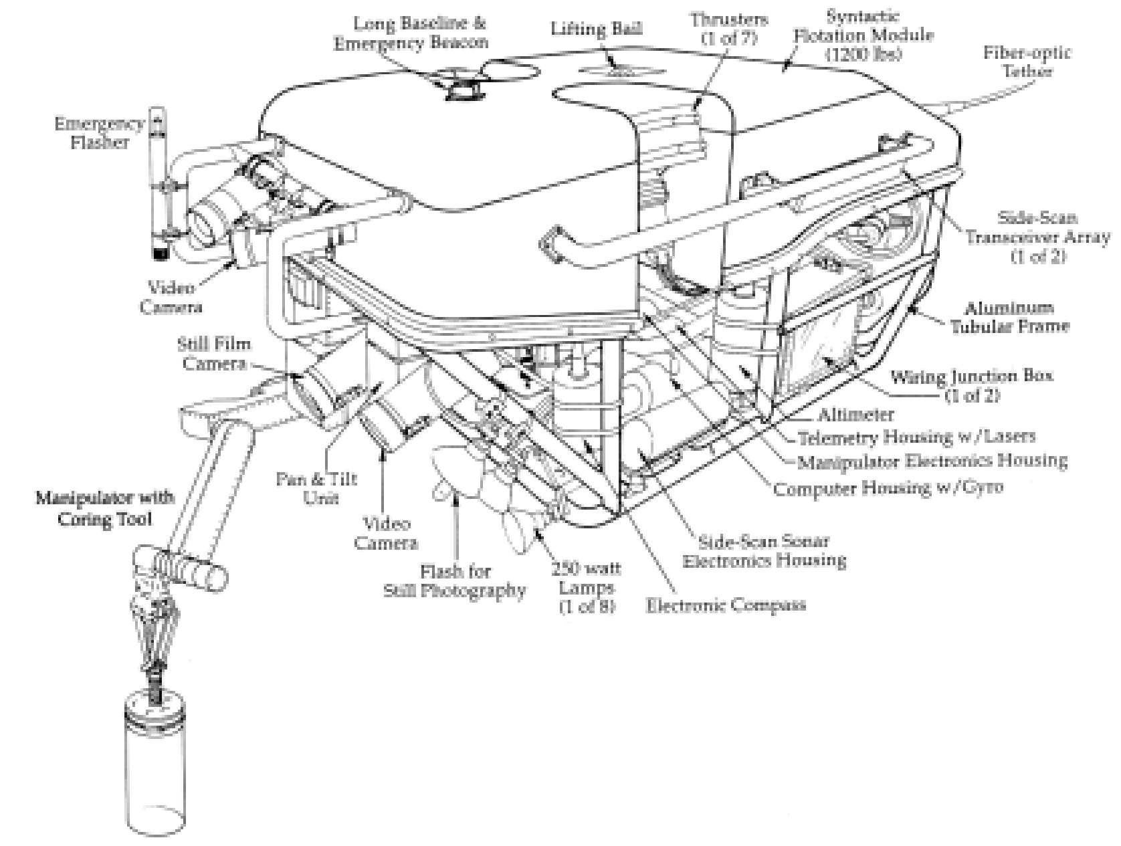
Figure 6.9
Jason is an
underwater, remote-
controlled vehicle
that has been used to
explore the wreckage
of the Lusitania. The
manipulator and
camera comprise
some of the vehicle’s
control systems.

Slide 11
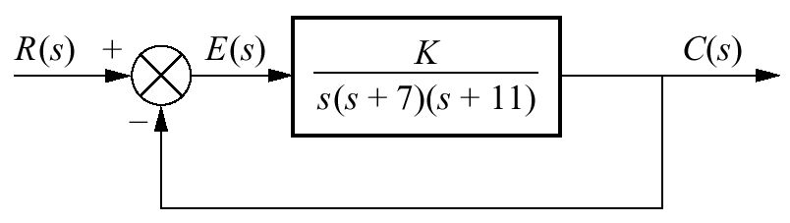
Figure 6.10
Feedback control
system for Example
6.9

Slide 12
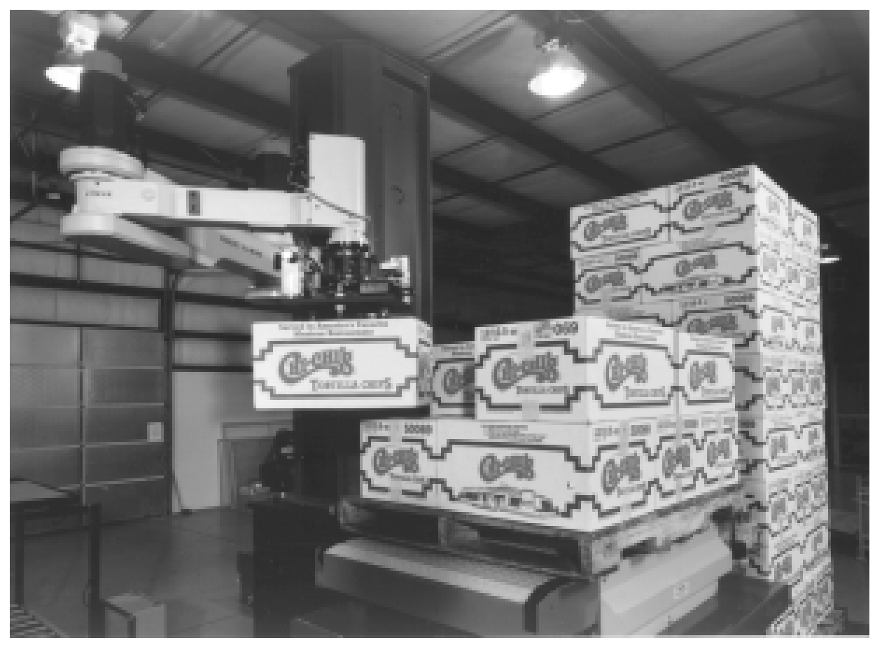
Figure 6.11
The FANUC Robot
M- 400 can be
configured for 4-
or 5- axis of motion.
It is seen here
moving and
stacking boxes.

Slide 13
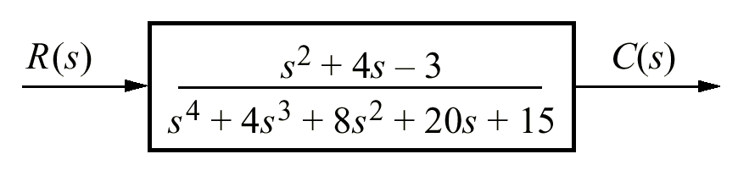
Figure P6.1

Slide 14
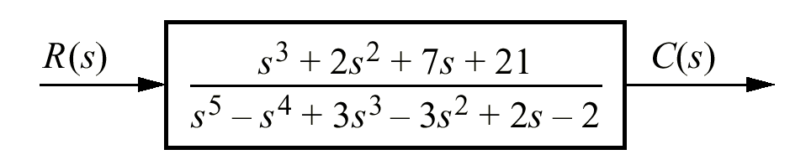
Figure P6.2

Slide 15
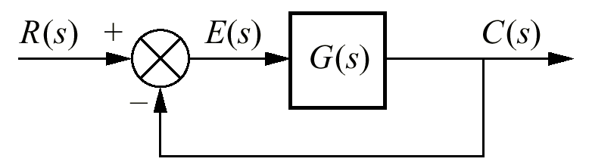
Figure P6.3

Slide 16
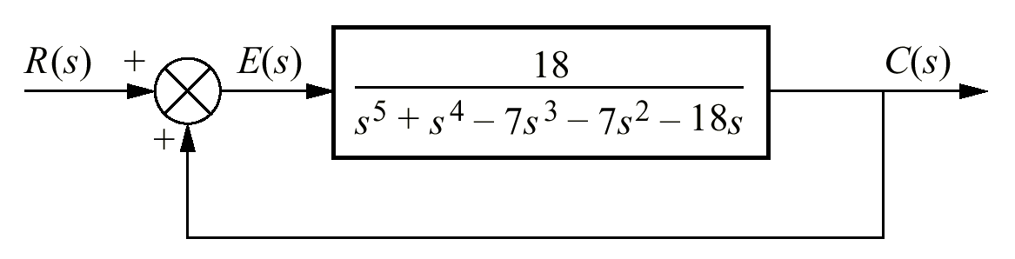
Figure P6.4

Slide 17
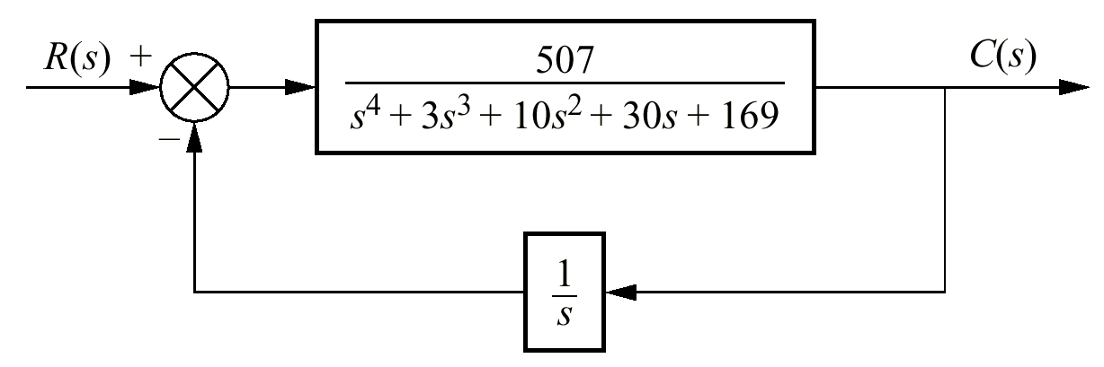
Figure P6.5

Slide 18
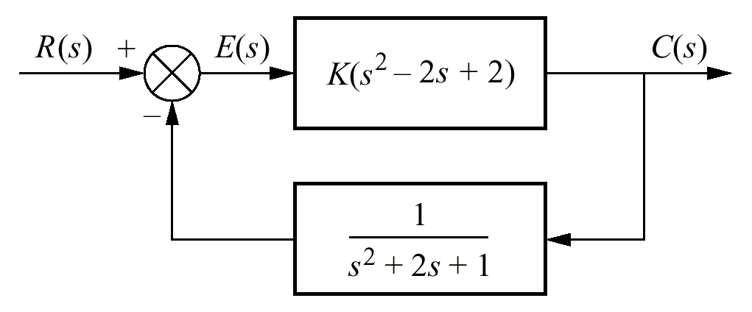
Figure P6.6

Slide 19
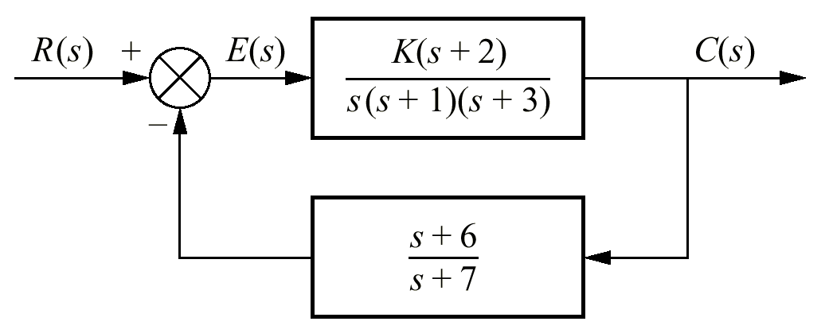
Figure P6.7

Slide 20
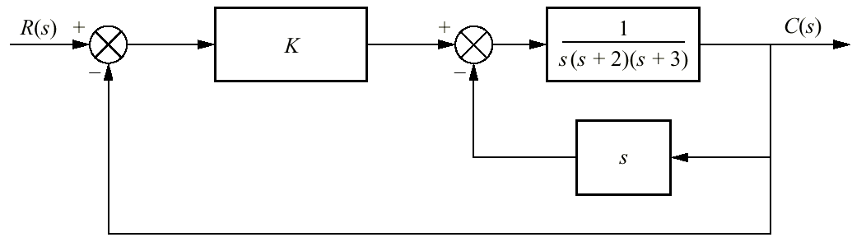
Figure P6.8

Slide 21
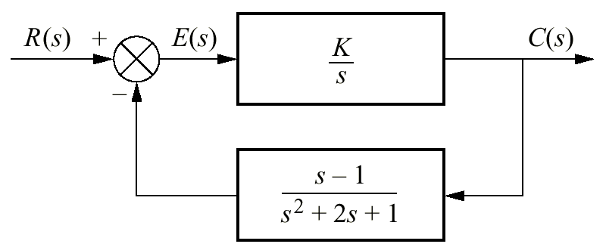
Figure P6.9

Slide 22
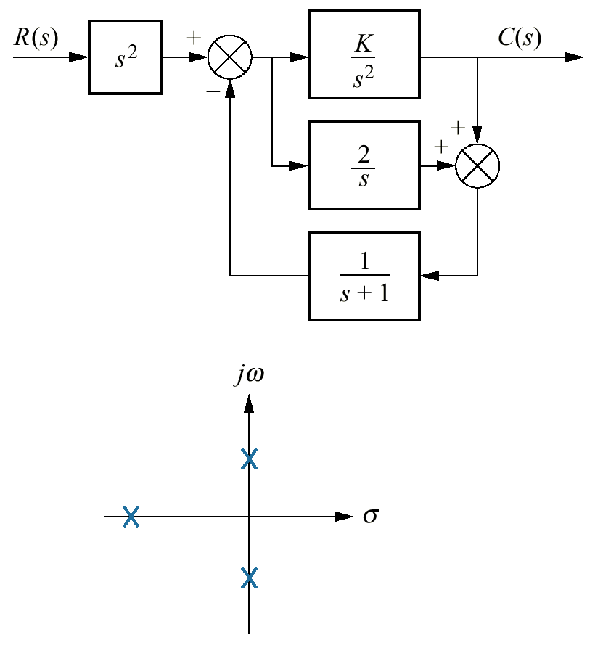
Figure P6.10
Closed-loop system
with pole plot

Slide 23
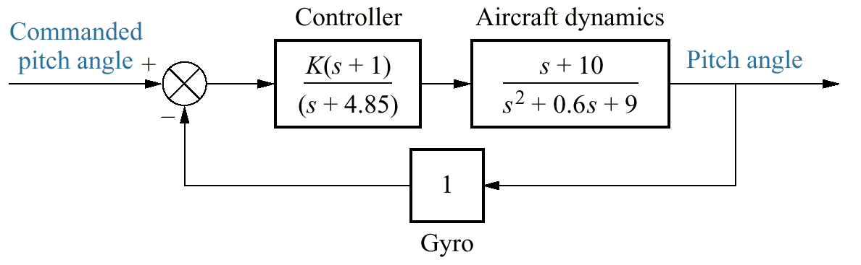
Figure P6.11
Aircraft pitch loop
model

Slide 24
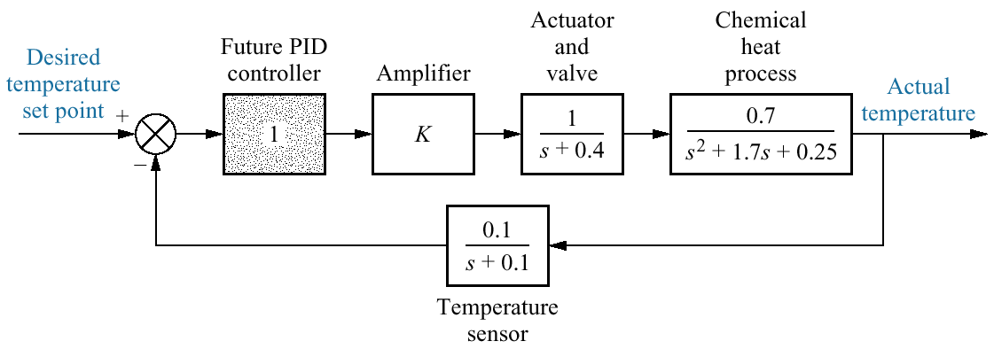
Figure P6.12
Block diagram of a
chemical process-control
system

Slide 25
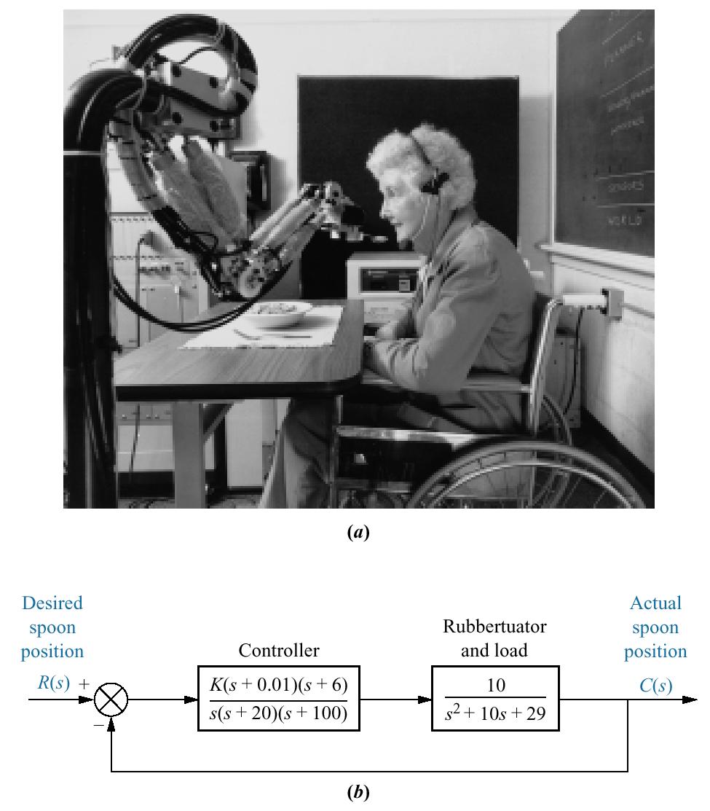
Figure P6.13
a. Soft Arm
used for
feeding;
b. simplified
block
diagram

Slide 26
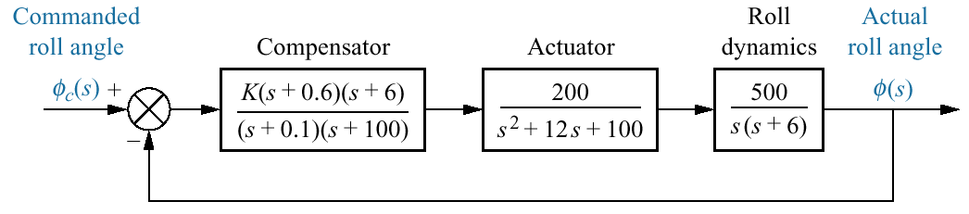
Figure P6.14
Towed vehicle roll
control

Slide 27
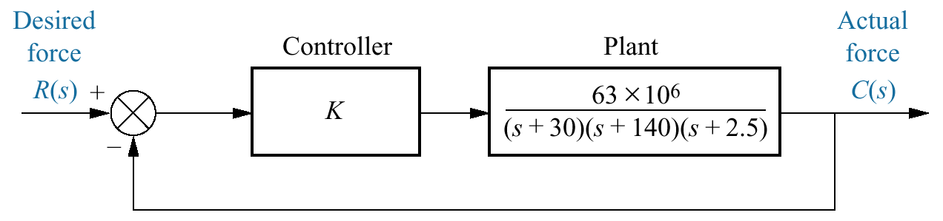
Figure P6.15
Cutting force control
system

Slide 28
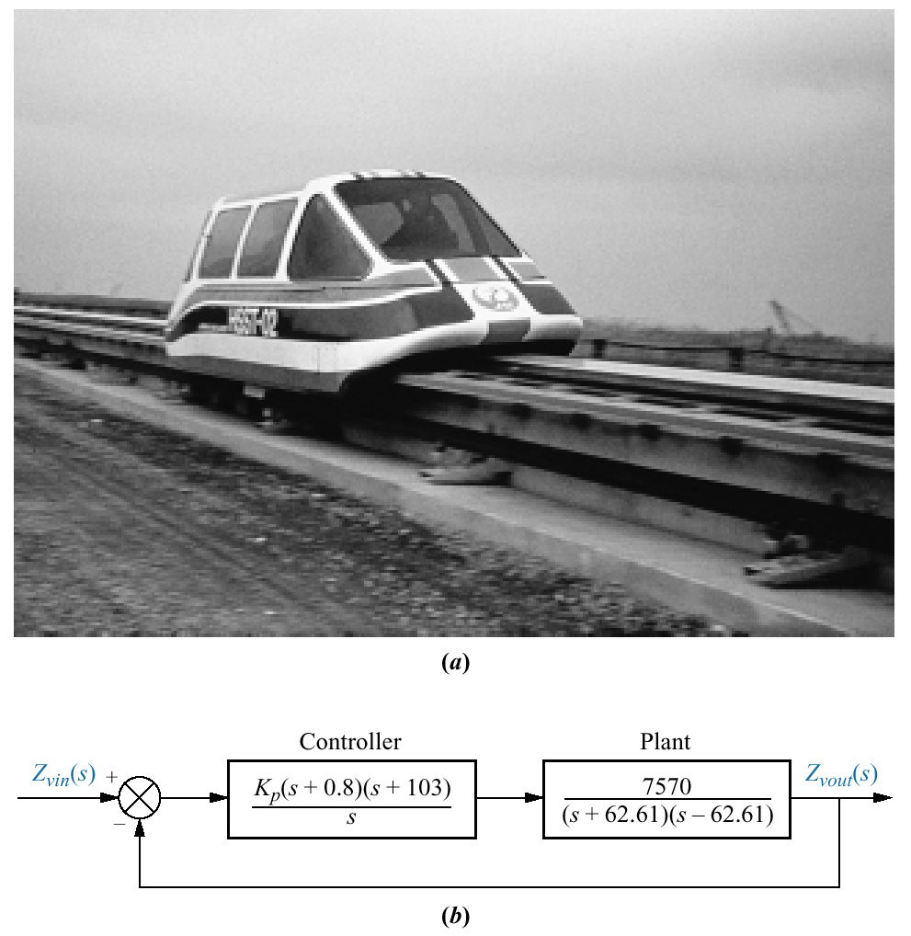
Figure P6.16
a. A magnetic
levitation
transportation system
(©1998 IEEE);
b. simplified block
diagram (©1998 IEEE)

